Slide 1
Customer Management System
Section 08
Ke-Hsin Yu

Slide 2
Purpose
Improve the efficiency of customer information management in a company

Slide 3
Function
Add
View
Add a new customer information
View all customers’ information
Remove
Update
Remove an existing customer information
Update an existing customer information
Exit
Close Application

Slide 4
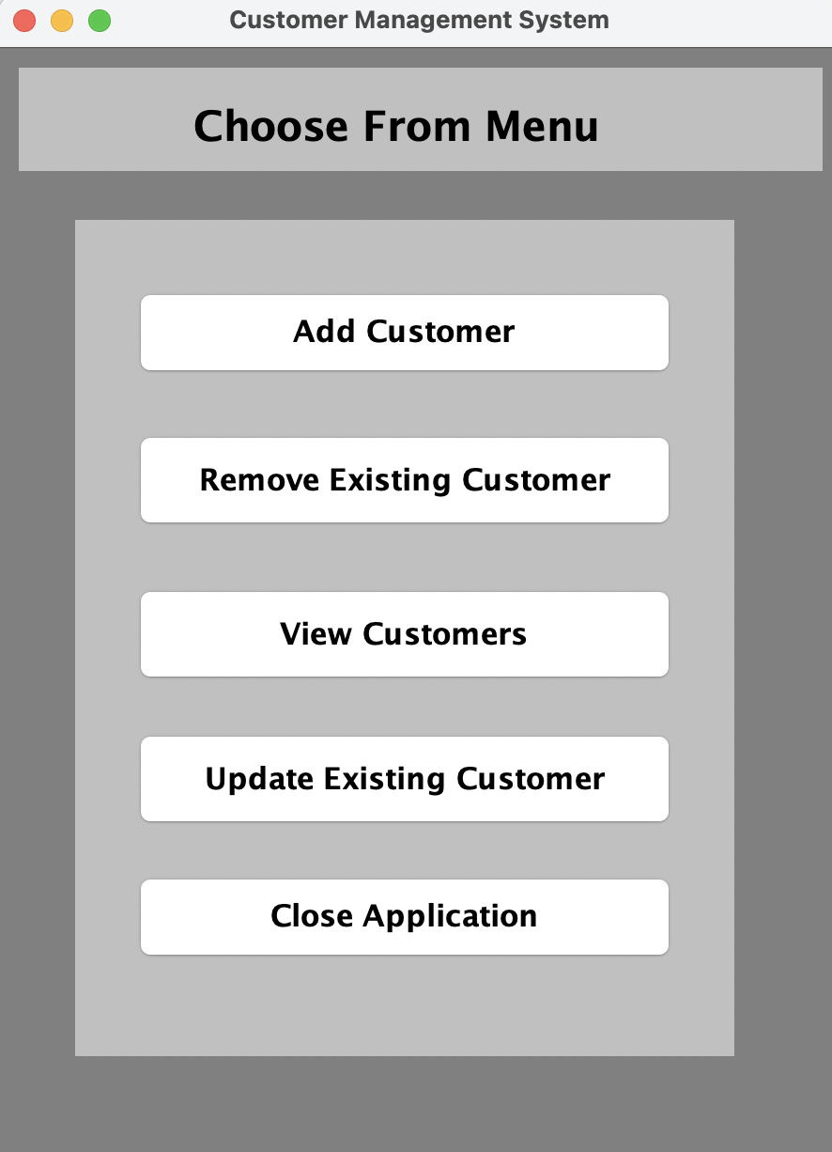
Demo Time

